Slide 1

Banking Analytics Dashboard
SHREYA KUMARI

Slide 2
Business Problem & Context
Modern banking institutions handle diverse customer segments across multiple financial products. However, without clear visibility into customer behavior, product usage, and income patterns, it becomes challenging to:
Understand key revenue-contributing customer groups
Monitor deposit and loan distribution
Identify high-value customer segments
Track product adoption across customer demographics
Support strategic financial decisions
This dashboard provides a centralized view of customer banking metrics to help decision-makers evaluate performance, optimize customer portfolios, and improve strategic planning.

Slide 3

Project Objectives & Performance KPIs
Objective | Purpose
📌 Analyze customer banking behavior | Understand deposit & loan patterns across customer segments
📌 Identify high-value customer groups | Segment by income, occupation, banking type & gender
📌 Evaluate loan & deposit portfolio distribution | Assess contribution by relationship type & financial products
📌 Support financial decision-making | Provide insights for portfolio optimization & customer strategy
KPI | Description
💰 Total Loans | Sum of business lending, bank loans & CC balances
🏦 Total Deposits | Savings, checking & foreign currency balances
👥 Total Clients | Count of unique customers
📈 Average Income | Mean customer income
🏡 Avg Properties Owned | Asset indicator for wealth segment
📊 Business Lending Volume | High-value credit exposure

Slide 4

Data Source
Category | Fields
Customer Info | CustomerID, Gender, Joining Year, Nationality, Occupation
Financial Data | Bank Loans, Business Lending, Credit Card Balance, Bank Deposits, Checking Accounts, Saving Accounts, Foreign Currency Account
Income & Assets | Estimated Income, Properties Owned
📊 Dataset Summary
~3,000 customer records
Banking customer profile & product dataset
Includes demographics, income, loans & deposits
Source Format: CSV file
Data cleaned using Python (Pandas)
Visualized & modeled in Power BI
DAX used for KPI calculations

Slide 5

Methodology
🛠️ End-to-End Workflow
📁 Data
⬇︎
🧹 Cleaning
⬇︎
🧠 Modeling
⬇︎
🧮 DAX
⬇︎
📊Dashboard
⬇︎
🎯 Insights
Phase | Tasks
📥 Data Import | Loaded raw banking dataset (CSV)
🧹 Data Cleaning (Python) | Removed duplicates, formatted numeric values, standardized columns
🧠 Data Modeling (Power BI) | Created relationships, defined fact/dimension tables
📐 DAX Measures | Built KPIs like Total Loan, Total Deposit, Avg Income, Customer Count
🎯 Insights & Recommendations | Identified high-value customers and financial patterns

Slide 6
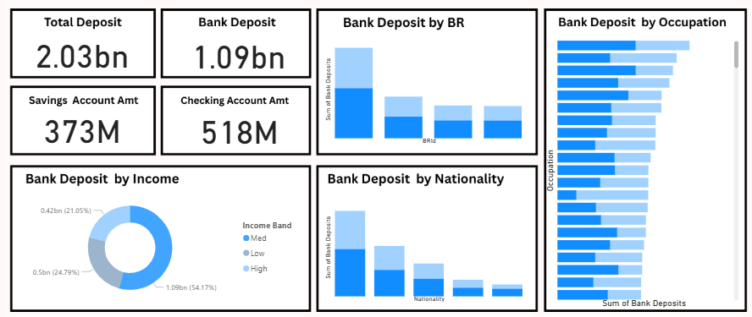

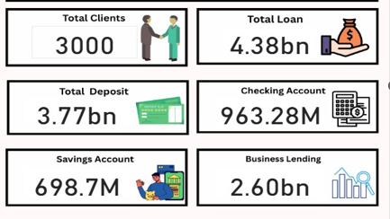
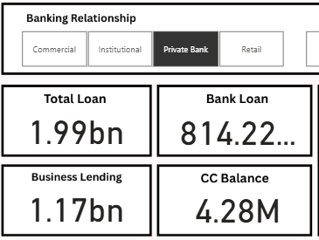
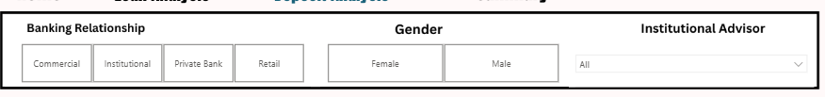
🎯 Dashboard Focus * Executive-level view of banking KPIs * Snapshot of customer profile & financial products * Quick insights into loan & deposit distribution
📊 Overall Banking Performance Dashboard

Slide 7

Strategic Conclusion
🧠 Key Strategic Outcomes
Identified high-value customer segments driving majority of deposits & lending
Highlighted wealth & business customers as core revenue contributors
Uncovered behavioral patterns tied to income, tenure, and asset ownership
Delivered data-backed recommendations to boost customer value & retention
🌟 Final Thought“The strength of a bank lies not only in its capital, but in understanding the customers who drive it.”
🚀 Impact Potential
With targeted product strategy and enhanced customer focus, the bank can achieve:
Impact Area | Benefit
💰 Profit Growth | Higher cross-sell & upsell to premium clients
🎯 Customer Focus | Personalized wealth, credit & advisory solutions
🔁 Retention | Stronger loyalty among long-tenure clients
🧩 Resource Allocation | Prioritize segments that drive maximum value

